Slide 1

MM&a Pilot Ad program
Finding customer’s favorite ads
Oct. 16, 2022 Prepared by Erin Ren

Slide 2
Overview
Subtitle
Introduction
Customer Analysis
Manufacturer Analysis
Conclusion
5/28/18
This is the slide footer, which can be edited under Header & Footer, along with slide numbers and date

Slide 3
Introduction
Subtitle
MM&A is a national supermarket, that is seeking to utilize the digital channel, and input ad space for customers.
Our goal is to find potential manufacturers that can be introduced to ad space, and promote their products.
For MM&A, the ad space will be able to track ROI, and allow the company to provide more insight to the business.
In addition, we want to target national brand manufacturer.
5/28/18
This is the slide footer, which can be edited under Header & Footer, along with slide numbers and date

Slide 4
Who is viewing the ad space?
Subtitle
Frequent Buyer
Customers buying discounted product frequently
Discount Seeker
targeted customer group
5/28/18
This is the slide footer, which can be edited under Header & Footer, along with slide numbers and date

Slide 5
Overview of targeted customers
Subtitle
Purchased product Frequently
Primary Targeted Group
Purchased amount above most of the customers
Find more profitable customers
By locating the top 25-percentile of each group, we matched 2 lists, and generated 541 customers who satisfy both criterias. On group average, each customer purchased $3461.42 in 2 years, and performed 536 purchases.
5/28/18
This is the slide footer, which can be edited under Header & Footer, along with slide numbers and date

Slide 6
Targeted Customer Demographics
(Out of 79% of the original group, due to lack of record of other customers)
Age Distribution
Homeowner Distribution
Majority Group: 44-55 + Homeowner 23.78% & 35-44 + Homeowner 20.34%
5/28/18
This is the slide footer, which can be edited under Header & Footer, along with slide numbers and date

Slide 7
Targeted Customer Key Information
Top 5 Manufacturers
(National)
2: $51287.28
Fruit, Vegetable,Produce
50.41% of sales by majority group
764: $30497.11
Warehouse Snack, Detergent
46.57% of sales by majority group
1208: $18878.90
Soft Drink
42.66% of sales by majority group
103: $17306.73
Soft Drink
36.88% of sales by majority group
317: $16001.72
Cheese, Salad Dressing
46.00% of sales by majority group
5/28/18
This is the slide footer, which can be edited under Header & Footer, along with slide numbers and date

Slide 8
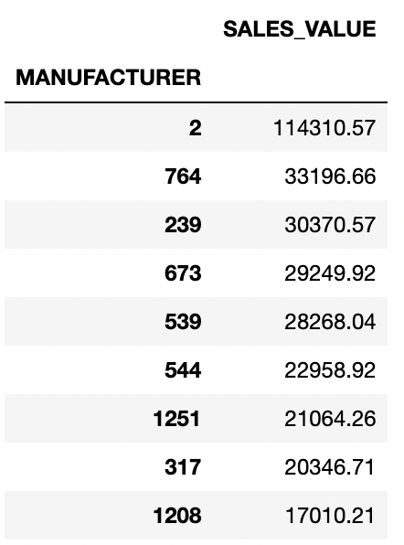
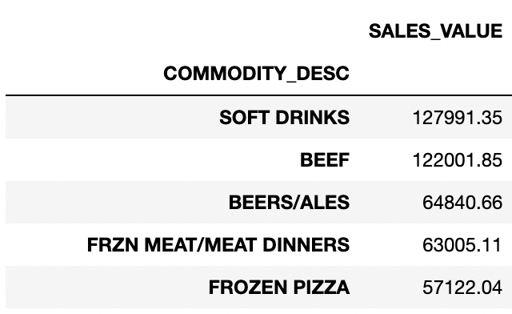
Additional Support
Subtitle
Overall Commodity Popularity
Un-discounted product total sale
Most popular commodity type
Top 10 national manufacturers
When no promotion
5/28/18
This is the slide footer, which can be edited under Header & Footer, along with slide numbers and date

Slide 9
Conclusion
Subtitle
Manufacturer 1208 should be select as the major collaborating parties, since it would attract most of our active customers, and thus provide us a good insight of ad space functionality.
Benefiting from 1208’s popularity, the customers’ interaction with the ad space would be abundant.
For 1208, since it still has potential customers, it will be beneficial for them to have a commercial for more customers.
5/28/18
This is the slide footer, which can be edited under Header & Footer, along with slide numbers and date

Slide 10
Thank you!

